Slide 1
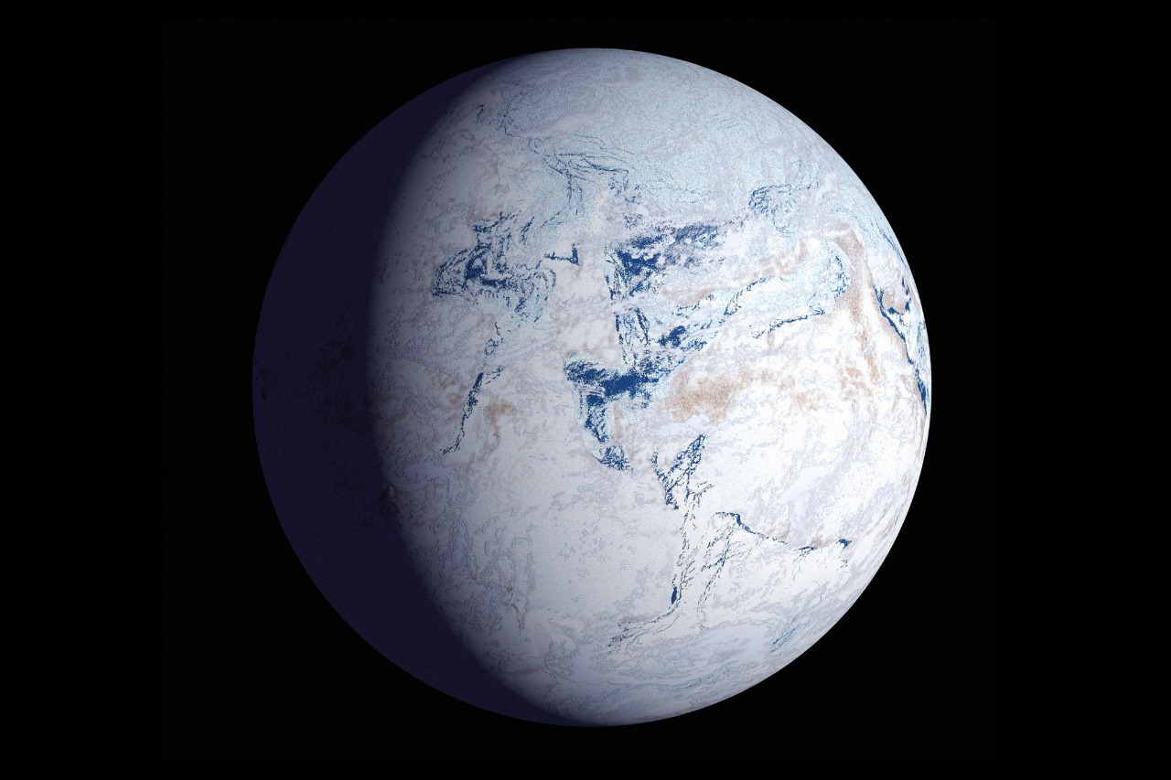


BEYOND sunlight: an aquatic chemosynthetic world
TEAM MEMBERS:
SANJAYKRISHNA V
SIVASHANKAR S
RAHULRANJAN PM
SRI SUDHAN KS
MANIKANDAN T
NIKESH S

Slide 2

What’s is CHEMOSYNTHESIS
Organisms use chemical reactions to oxidize inorganic compounds or ferrous ions, releasing energy that they use to combine carbon dioxide and hydrogen to create sugar. Chemosynthesis occurs in many parts of the ocean, especially in dark regions.
Hydrogen Sulfide Chemosynthesis:
6CO2+6H20+3H2S →C6H12O6+3H2SO4
In this process, bacteria use hydrogen sulfide as a source of energy and produce sulfuric acid (H₂SO₄) as a byproduct.
Methane Chemosynthesis:
CO2+4H2 → CH4+2H2O
This reaction can be found in methane-rich environments, such as cold seeps or methane hydrates.

Slide 3
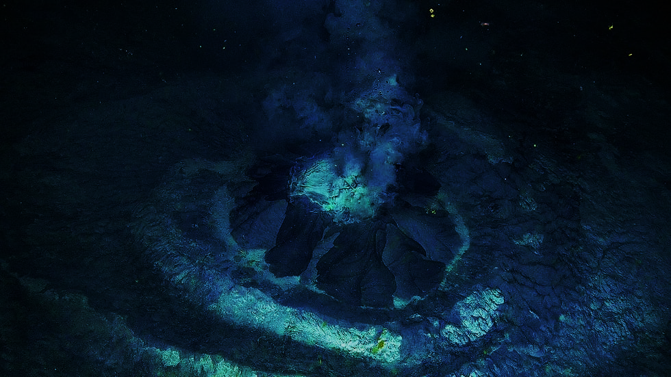
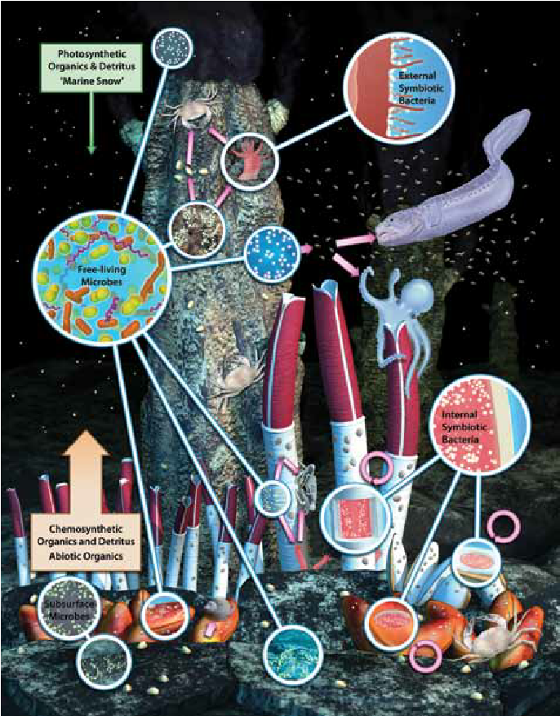
Chemosynthetic Ecosystem
Chemosynthetic ecosystems are environments where chemosynthesis, the process of converting carbon into organic matter, is the primary source of energy for life.
Hydrothermal vents: These are found near tectonically active margins and underwater volcanoes, and are characterized by high biomass due to the local food source provided by chemosynthetic microbes.
Cold seeps: These are similar to hydrothermal vents, but are characterized by high levels of methane and sulfides that seep out of the sediment.
Energy source:The oxidation of inorganic compounds like hydrogen sulfide, ammonia, nitrite, carbon monoxide, and iron.

Slide 4
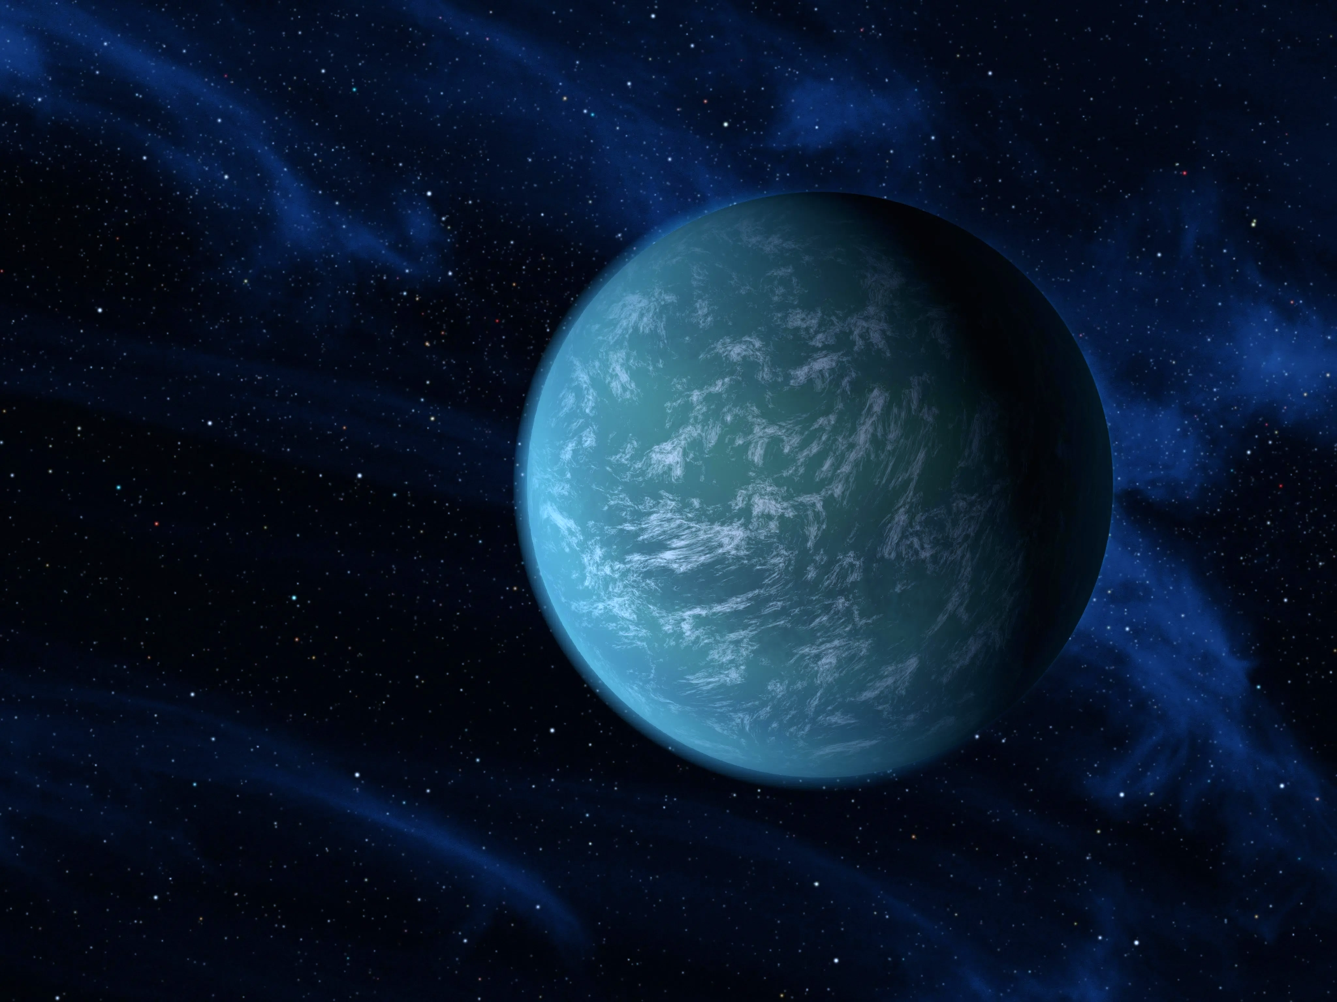
Hypothetical Alien Chemosynthetic Lifeforms
Microbial Life: In the cold, dark oceans beneath the ice, life could begin with chemosynthetic bacteria or archaea, just like on Earth.
Complex Life: With sufficient time, larger organisms might evolve, resembling tube worms or crustaceans, living off chemosynthetic bacteria or grazing on mats of microbial life.
Floating Chemosynthetic Organisms: Lifeforms might float in the atmosphere, absorbing chemicals like methane or hydrogen sulfide and converting them to energy through chemosynthesis.
Subterranean Life: In cave systems or beneath the surface, lifeforms might evolve similar to those in Earth's deep subsurface environments, surviving off chemical energy derived from volcanic gases.

Slide 5
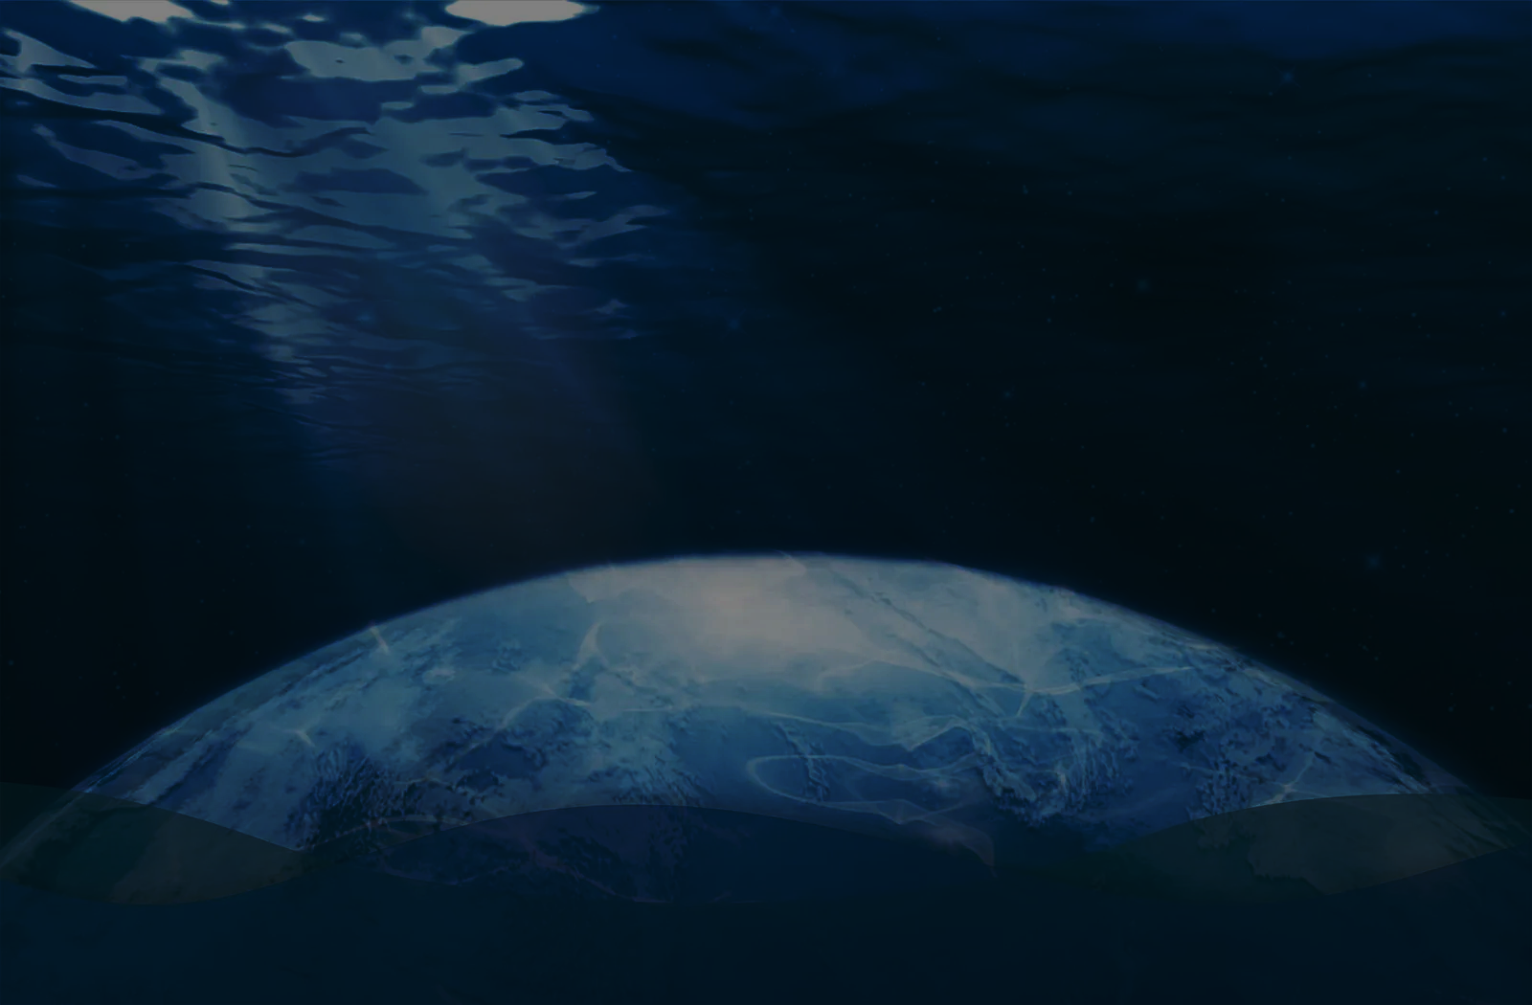
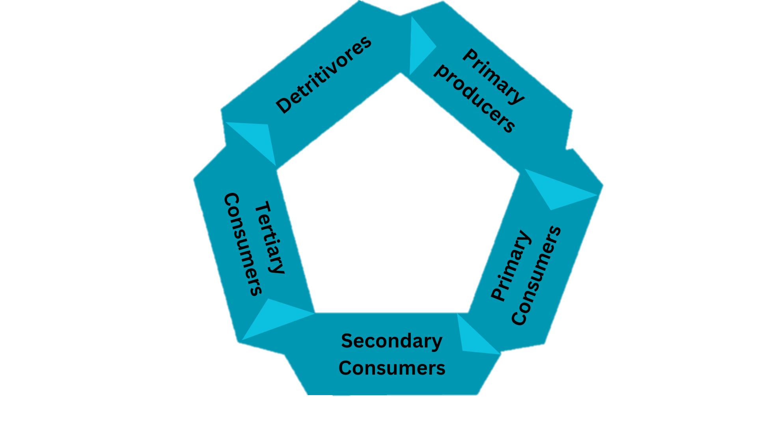
Hypothetical food chain of Ocean world
Primary Producers:
-These organisms use chemosynthesis to convert chemicals into energy.
Chemobacta , Ventophiles.
Primary Consumers:
-These animals consume the primary producers
-Ventwhales, Siphonfins, Chemosponges.
Secondary Consumers:
-These organisms prey on primary consumers
-Glowfin, Crustaclaws, Ventshark.
Tertiary Consumers :
-The top of the food chain, these large predators prey on secondary consumers.
-Chemovores, Abyssal Leviathan, Darkfin.
Detritivores:
-Detritivores are organisms that eat dead or decaying organic matter.
Hypothetical food chain
Of
Ocean world

Slide 6
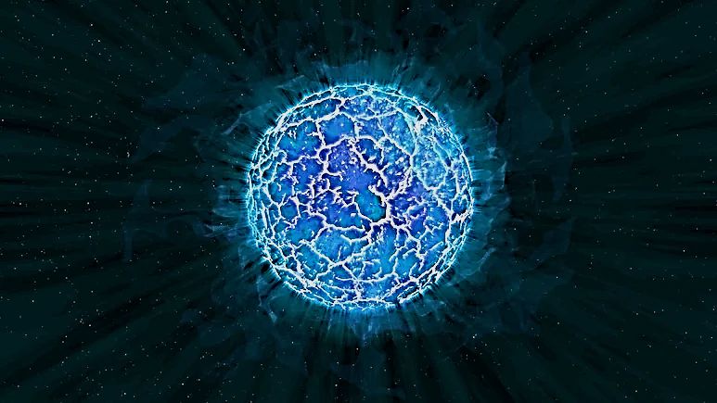
COMPOSITION OF OCEAN WORLD

Slide 7
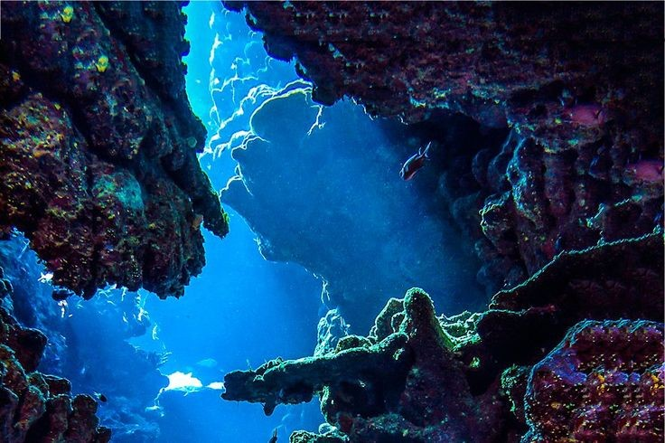
Our Website 🔗:
https://rahulranjan030206.github.io/html-final/
TOOLS USED:
VS CODE
GEMINI
RUNWAY
DaVininc Resolve
Blender
REFERENCE:
https://science.nasa.gov/toolkit/oceanworlds/
https://oceanexplorer.noaa.gov/edu/materials/chemosynthesis-fact-sheet.pdf

